Slide 1

CURSE OF RESURRECTION RPG GAME
Project Supervisors: Ms.D.Ramalakshmi.M.E,Ph.D.,/ Mr.K.Arunkumar. M.E.(PhD)
Name of the Students:
Lokesh varan N – 42120120
Jerome Richard D – 42120094
Jayanth R – 42120089

Slide 2
ABSTRACT
Curse of Resurrection is a 3D open-world RPG that offers an immersive narrative-driven experience combined with archery-based combat. The game follows Erika, a former assassin turned archer, on a dangerous journey through Dering Woods to resurrect her deceased husband, Wayne. To achieve this, she must defeat three powerful monsters — Chupacabra, Cerberus, and Windigo — before confronting Shinigami, the Death God, who demands "a soul for a soul."
The game features a detailed open world with diverse biomes such as forests, caves, mountains, and ancient ruins. The combat system focuses on player skill, utilizing archery, stealth, and positioning without any upgrade or skill tree system.
Advanced AI-driven enemies using NavMesh Agents provide dynamic challenges, while a custom dialogue system allows player choices to influence interactions and story progression. The game employs environmental storytelling, realistic weather effects, and optimized performance techniques like LOD and occlusion culling for smooth gameplay.
Overall, Curse of Resurrection delivers a dark, atmospheric adventure where player-driven choices and emotional depth create an engaging and memorable experience.

Slide 3
INTRODUCTION
Curse of Resurrection is a 3D open-world role-playing game (RPG) created using Unity, centered around a compelling story of love, sacrifice, and destiny. The game follows Erika, a former assassin turned skilled archer, who sets out on a dangerous journey through the eerie and mythical Dering Woods to bring her deceased husband, Wayne, back to life. To succeed, Erika must face and defeat powerful monsters like Chupacabra, Cerberus, and Wendigo, and ultimately confront the Death God (Shinigami) who demands a soul in exchange for a soul.
This project combines immersive storytelling with strategic archery-based combat, realistic environments, and AI-driven enemies. The game’s atmosphere is enhanced by detailed visual and sound design, creating a haunting yet beautiful world. Through this project, the aim is to deliver a unique gaming experience that blends emotion, gameplay challenge, and artistic design.

Slide 4
SOFTWARE REQUIREMENTS
Game Engine: Unity 3D (2021 or above)
Scripting Language: C#
IDE: Visual Studio / Visual Studio Code
Graphics Tools (Optional): Blender / Adobe Photoshop / GIMP
Dialogue System Asset: Dialogue Editor (Unity Asset Store)
Build Platform: Windows

Slide 5
HARDWARE REQUIREMENTS
Processor (CPU): Intel Core i5 (or AMD equivalent) or higher
RAM: Minimum 8 GB (Recommended: 16 GB or more)
Graphics Card (GPU): NVIDIA GTX 1050 or higher (or equivalent)
Storage: At least 10 GB of free disk space
Display: 1080p resolution monitor or higher
Input Devices: Keyboard and Mouse

Slide 6
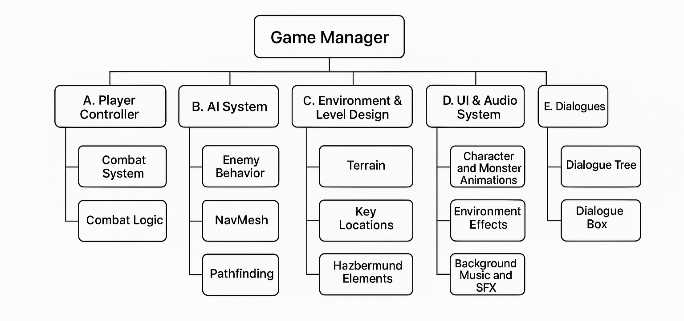
Architecture diagram

Slide 7


Curse of Resurrection: A Dark RPG Adventure
Embark on a journey into Dering Woods in Curse of Resurrection, a 3D open-world RPG built in Unity. Confront moral dilemmas and fearsome creatures in a quest for resurrection.
by Lokesh Varan

Slide 8

Game Overview
Genre
Platform
3D Open-World RPG
PC (Unity Engine)
Character
Goal
Erika, the Archer
Resurrect her husband
Curse of Resurrection blends immersive exploration with strategic combat, set in a hauntingly beautiful world.

Slide 9

Storyline
Wayne's Demise
1
Dies mysteriously
2
Demon Tree
Seek Death God
Three Trials
3
Defeat guardians
4
Soul for Soul
Erika's sacrifice
A tale of love, loss, and the ultimate sacrifice, Curse of Resurrection pulls players into a dark and emotional journey.

Slide 10




Game Mechanics
Combat
Bow and Arrow, LMB Aim, RMB Shoot
Movement
WASD, Shift Sprint, Space Jump
Dialogue
Harmony System
Engage in intuitive combat and navigate meaningful dialogues that shape Erika's path in the game.

Slide 11
World Design
Dering Woods
Diverse Locations
Hidden Elements
Dark, eerie, secrets
Forests, caves, temples
Past traveler remnants
Explore the haunting beauty of Dering Woods, a world filled with danger, mystery, and forgotten tales.

Slide 12

Enemies & Challenges
Chupacabra
Cerberus
Fast, aggressive
Fire attacks
Wendigo
Stealthy, high damage
Face formidable foes, each testing Erika's skills and resolve in unique ways, culminating in a confrontation with the Death God.

Slide 13
Technical Aspects
1
Terrain Editor
2
NavMesh Agent
3
TextMeshPro
Built with Unity, Curse of Resurrection utilizes advanced tools and systems to create a visually stunning and engaging player experience.

Slide 14
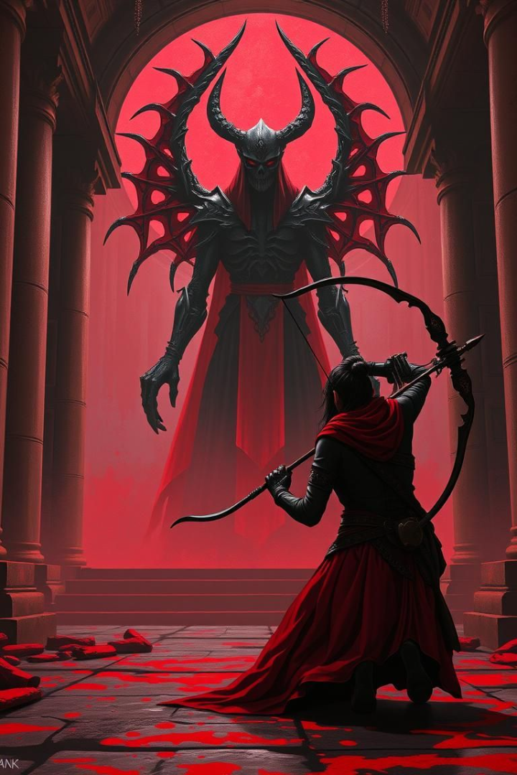
Conclusion
RPG
Moral
Compelling
Unique
Story-driven
A soul for a soul
Future
Improvements
Side quests
Curse of Resurrection delivers a captivating RPG experience with immersive combat, exploration, and a profound moral choice.

Slide 15
CONCLUSION
"Curse of Resurrection" is a 3D open-world RPG developed using Unity, featuring an emotionally-driven storyline, dynamic boss battles, and immersive level design.
The player follows Erika, an archer who traverses cursed lands to resurrect her lost husband, encountering monsters and moral decisions.
It demonstrates strong technical implementation and creative design in Unity, showcasing your skills in narrative building, level design, and gameplay mechanics.
The game integrates AI navigation, dialogue systems, and biome variety to enhance the player's journey and engagement.

Slide 16
BENEFITS
Practical Experience with Unity tools, AI, animations, and terrain design
Storytelling Skills through character arcs, emotional stakes, and consistent worldbuilding
Game Design Understanding including mechanics balance, player guidance, and challenge scaling
Problem Solving via real-time debugging, asset integration, and system linking (e.g., NavMesh + Dialogue System)
Portfolio Ready – A fully playable game project ideal for showcasing in resumes or interviews

Slide 17
REFERENCE
[1] Akram.A, Tehseen.R, Saqib.S, Nazir.F, Awan.M, and Jr.I, “Advanced AI Mechanics in Unity 3D for Immersive Gameplay. A Study on Finite State Machines & Artificial Intelligence,” International Journal of Innovations in Science and Technology, vol. 6, pp. 2004–2023, Dec. 2024, Doi: 10.1145/3267851.3267896.
[2] Alvin.R, Yoga.P, and Alim.C, “Perancangan dan Implementasi Game RPG Cerita Rakyat Si Pitung (Rewrite Storyline Perjuangan Si Pitung),” Jurnal Rekayasa Sistem Informasi dan Teknologi, vol. 2, pp. 1132–1143, Feb. 2025, Doi: 10.70248/jrsit.v2i3.1927.
[3] Chen.S, “Tower Defense Game Design Based on Unity3D,” Frontiers in Computing and Intelligent Systems, vol. 6, pp. 85–94, Dec. 2023, Doi: 10.54097/fcis.v6i1.16.
[4] Chi.C, Jian.H, Tsair.C, Siang.C, and Ching-Mu.C, “Analysis and Implementation for the RPG Boxing Game,” Applied Mechanics and Materials, vol. 851, pp. 595–598, Aug. 2016, Doi: 10.4028/www.scientific.net/AMM.851.595.
[5] de Byl.P, Holistic Game Development with Unity 3e: An All-in-One Guide to Implementing Game Mechanics, Art, Design and Programming, 3rd ed. Boca Raton, FL, USA: CRC Press, 2019, Doi: 10.1201/9781351053693.

Slide 18
REFERENCE
[6] Foriansyah.M and Taurusta.C, “Design and Build an RPG Game ‘Drop the Dragon’ as a Medium for Practicing Mathematics Using the Finite State Machine Method,” Procedia of Engineering and Life Science, vol. 2, Aug. 2022, Doi: 10.21070/pels.v2i2.1233.
[7] Fraser.J, Papaioannou.I, and Lemon.O, “Spoken Conversational AI in Video Games - Emotional Dialogue Management Increases User Engagement,” in Proc. ACM, Oct. 2018, Doi: 10.1145/3267851.3267896.
[8] “Game Special Effect Simulation Based on Particle System of Unity3D,” in Proc. IEEE/ACIS 16th Int. Conf. Computer and Information Science (ICIS), Wuhan, China, May 2017, Doi: 10.1109/ICIS.2017.7960062.
[9] Hernandez.R, “Roll 20 for a Successful Compile: A Game Development RPG,” in Proc. DiGRA 2024 Conf.: Playgrounds, Sep. 2024, Doi: 10.26503/dl.v2024i1.2219.
[10] Iuppa.N and Borst.T, End-to-End Game Development. Burlington, MA, USA: Elsevier, 2010, Doi: 10.4324/9780080952246.

Slide 19
THANK YOU

